Slide 1

Introduction to Jenkins
Module 10: Build Tools and Language Integration

Slide 2
Topics
Maven, Gradle, and Java builds
Node.js, npm, and test runners
Python builds and virtual environments
.NET, container-based builds, and cross-platform agents

Slide 3
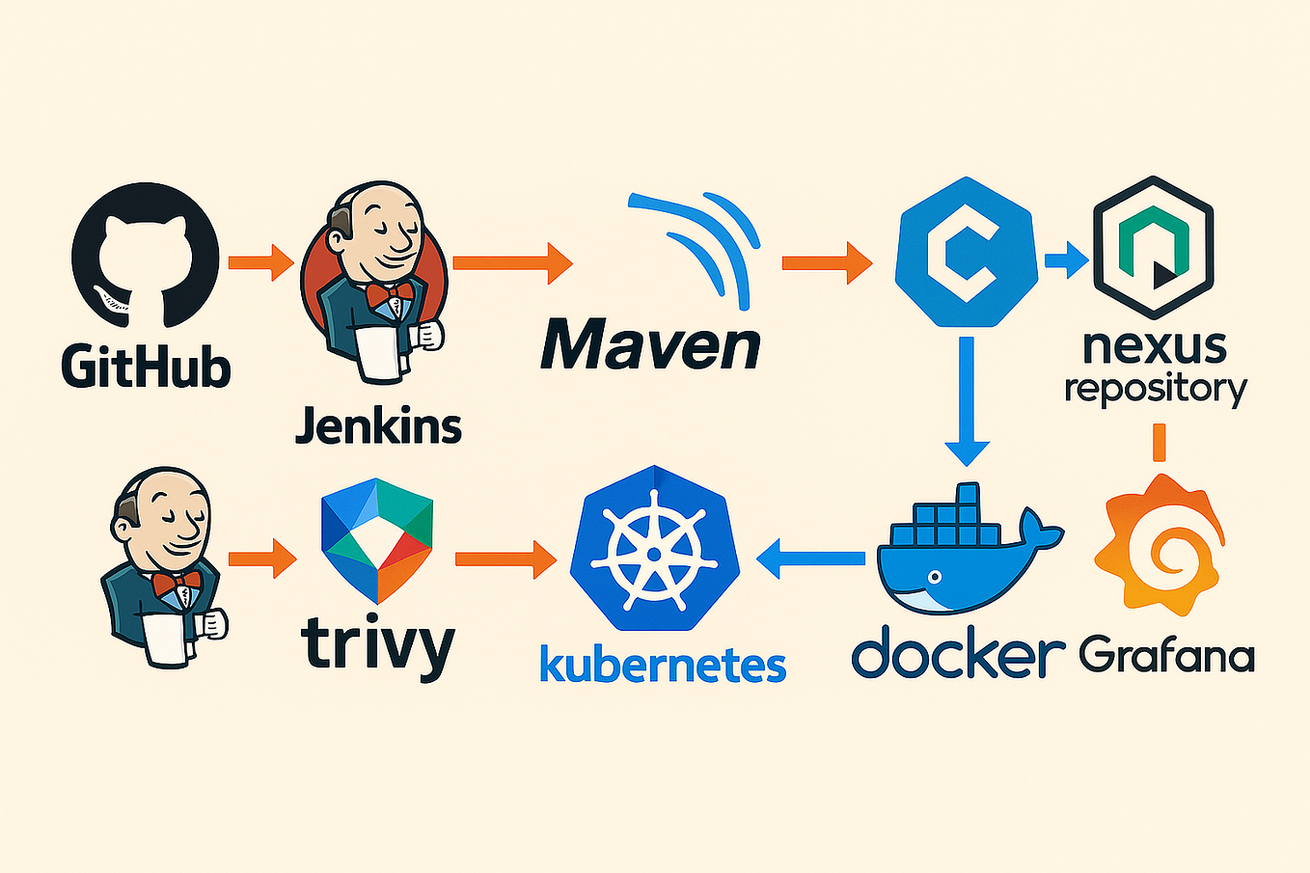
Maven, Gradle, and Java Builds
Jenkins originated in the Java ecosystem
Support for Java builds is
  Mature
  Well documented
  Deeply integrated
Java builds in Jenkins typically rely on
  Maven or Gradle
  JDK installations
  Dependency repositories (class libraries)

Slide 4
Maven Builds
Maven is a convention-driven build tool
  In Jenkins
    mvn commands are executed as pipeline steps
    JDK and Maven versions are managed via global tools
    Build results and test reports are easily published
  Typical pipeline actions
    Compile code
    Run unit tests
    Package artifacts (JAR/WAR)
  Maven has its own build lifecycle phases that can be invoked from Jenkins

Slide 5
Gradle Builds
Gradle is a flexible, scriptable build tool
  In Jenkins
    Gradle builds are invoked via the gradle wrapper or CLI
    Caching improves performance but requires careful agent lifecycle management
    Gradle integrates well with Docker-based agents
  Gradle is often used when
    Builds are complex
    Performance tuning matters
    Multi-project builds exist

Slide 6
Java Based Tools
Common Java CI pattern
  Checkout code
  Set JDK version
  Run build tool
  Publish test results
  Archive artifacts
Jenkins does the orchestration
  Jenkins gets the code
  Hands the code off to the build tool
  Accepts the results of the build

Slide 7
Node.js and npm
JavaScript builds are
  Dependency-heavy
  Fast-moving
  Sensitive to environment differences across agents
Jenkins supports Node.js through
  Node installations
  Containerized environments
  Tooling plugins

Slide 8
Node.js and npm
In Jenkins pipelines
  npm install or npm ci installs dependencies
  Build scripts run via npm run
  Lock files ensure reproducibility
Best practice
  Use Docker agents to pin Node versions
  Avoid installing Node globally on static agents

Slide 9
Test Runners
Common JavaScript test runners
  Jest
  Mocha
  Cypress
  Playwright
In CI
  Tests are run headlessly
  Results are published as reports
  Stage failures block code merges

Slide 10
Python Builds
Python builds
  Depend heavily on environment isolation
  Require careful dependency management
  Benefit strongly from ephemeral agents
Tooling
  Many different tools require different Python versions, eg. PyTorch, TensorFlow
  And these require different module dependencies
  Historically, Python uses virtual environments to keep versioning and dependencies clean

Slide 11
Python Builds
In Jenkins pipelines
  Virtual environments isolate dependencies
  Prevent cross-build contamination
  Improve reproducibility
  Common tools
    venv
    virtualenv
    Poetry
    Conda
  Best practice
    Create virtual environments per build
    Avoid shared system Python environments

Slide 12
Python CI
Typical Python CI flow
  Create virtual environment
  Install dependencies
  Run tests (pytest, unittest)
  Publish test results
  Package artifacts (optional, depending on project)
Docker agents are commonly used to
  Control Python versions
  Eliminate system-level drift

Slide 13
Jenkins and .NET
Jenkins supports .NET via
  .NET SDK installations
  Cross-platform agents
  Container-based builds
Modern .NET:
  Runs on Linux, macOS, and Windows
  Integrates well with CI pipelines

Slide 14
Cross-Platform Builds
Jenkins can
  Build the same code on different OSes
  Use labeled agents for platform-specific work
  Run matrix builds for compatibility testing
Example use cases
  Windows only builds
  Linux container builds
  Mixed platform test suites

Slide 15
Cross-Platform Builds
Containers are increasingly used to
  Standardize build environments
  Avoid OS-specific issues
  Support multi-language stacks
A single Jenkins instance can
  Build Java, Node, Python, and .NET
  Use different containers per pipeline stage
  Share a common CI platform

Slide 16
Questions

